Slide 1
S-Store
The Fastest OLTP Database in the World
Notes:
My name is Vojin and I will present

Slide 2
Online Transaction Processing Market
Bread and Butter of the Enterprise
10 billion dollar market
Growing 15-20% every year
Notes:
Commodity

Slide 3
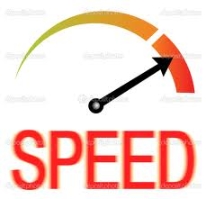
Need for Speed
Performance is important
15% using an in-memory + 32% will use it in 3 years
For 80% interviewees performance is a major concern
Expert knowledge
DB Administrator/Consultant

Slide 4
Competitors
Oracle/MS/SQL S-Store
Raw VoltDB
Notes:
Drop In Replacement

Slide 5
Performance (LOGOs)

Slide 6
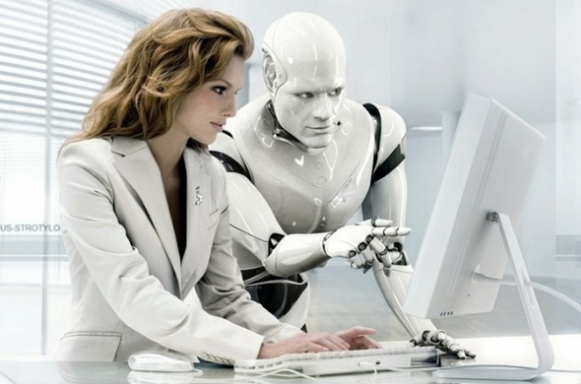
How did we get here?
Specialized Compiler Inside S-Store
Automatic Database Tuning
Notes:
Throw the Garbage Away (Intermediate Data structures, Boxing etc.)

Slide 7

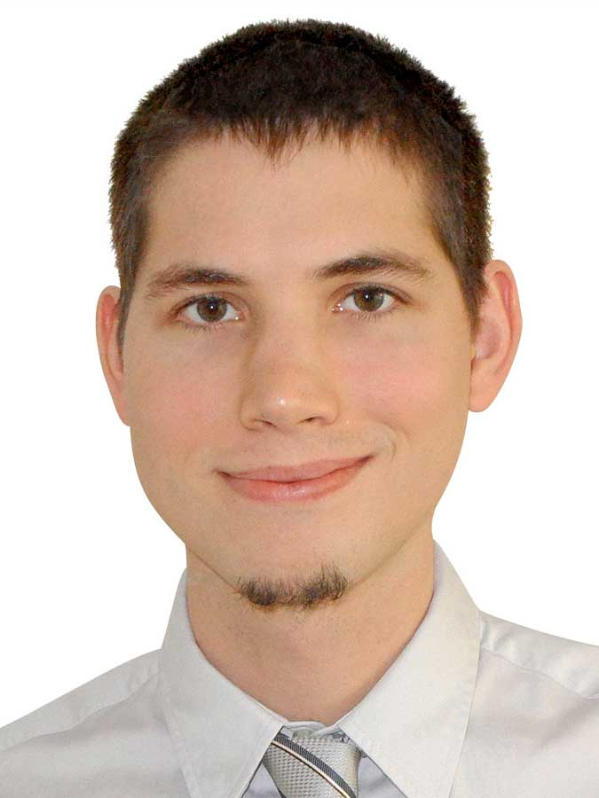

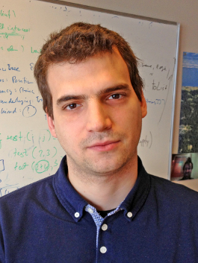
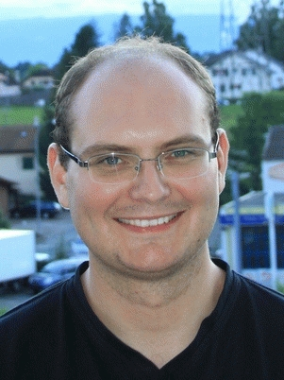
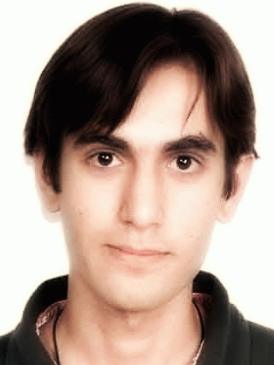
The DB Team
The Compiler Team

Slide 8
S-Store
The Fastest OLTP Database in the World

Slide 9



Path to Adoption
TODO (Better image) Recommendations based on real-time data
Smarter algorithms that maximize the added value
Better Trading Decisions

